Slide 1

GROUP 3
BAKERY-RECIVE FUNCTIONAL

Slide 2


USER TABLE
GUEST | Any customer visit website without log-in
USER | GUEST after Register and Login into the website
Retail Store | GUEST after Register to be a Store and Login into the website
Admin | All the colors used in this presentation

Slide 3



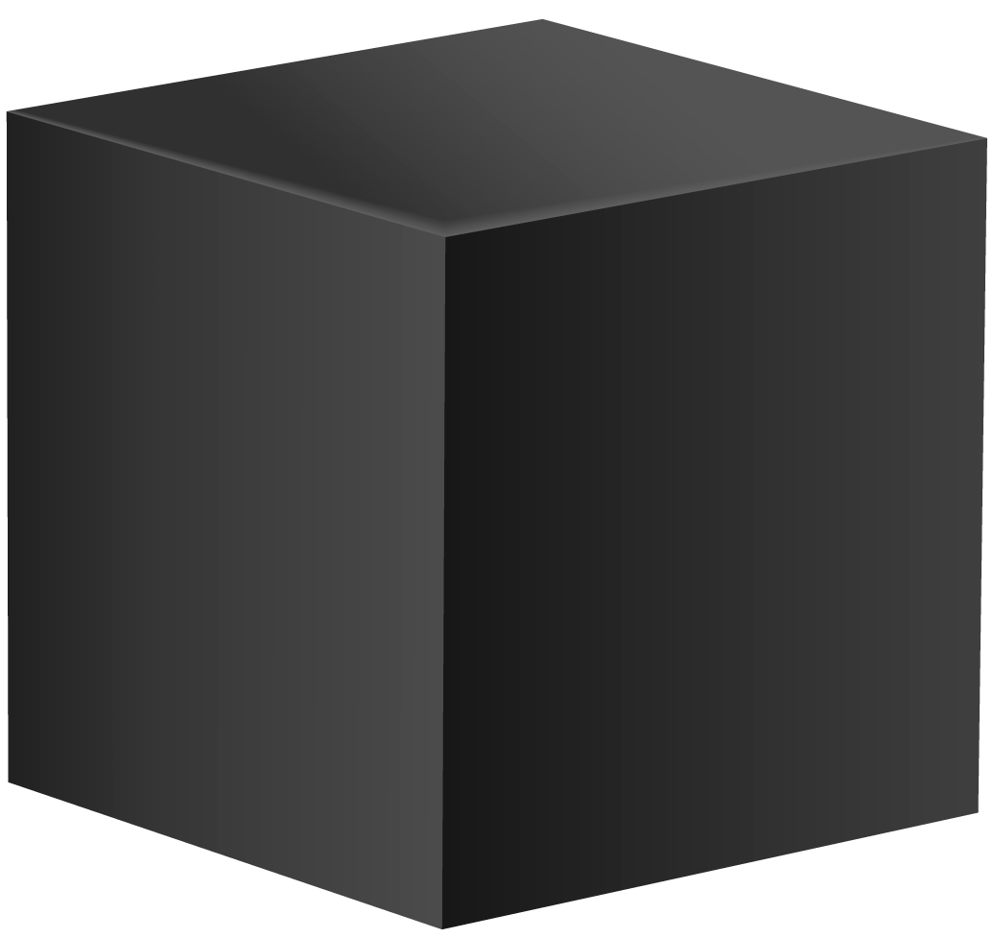

GUEST
- View recipe, blog.
- View Store List
- Add Ingredient to cart
- CRUD cart
- Register/Login to User
- Register/Login to Store

Slide 4
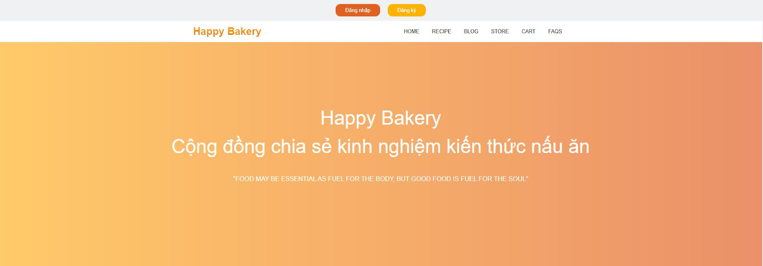
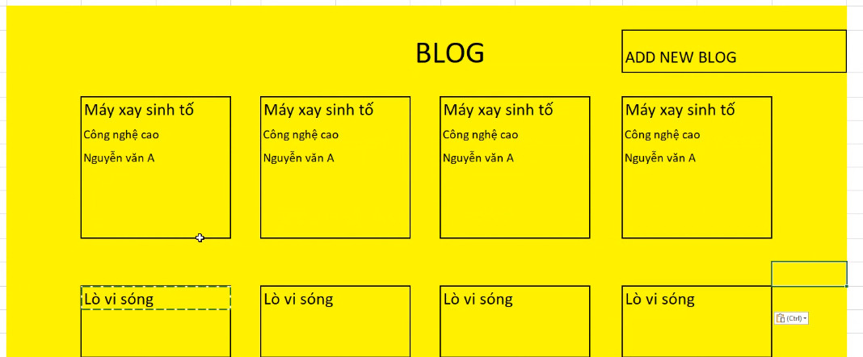
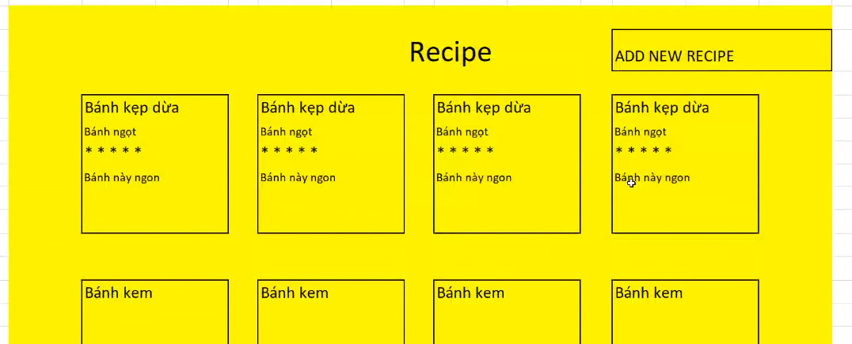
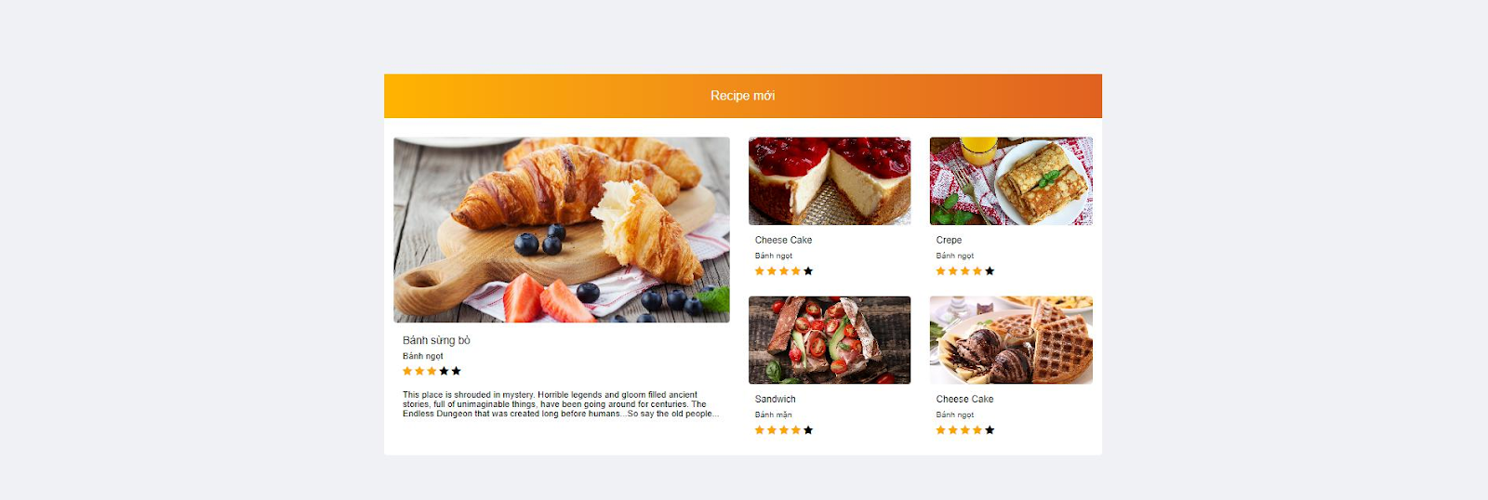
GUEST
View recipe, blog

Slide 5
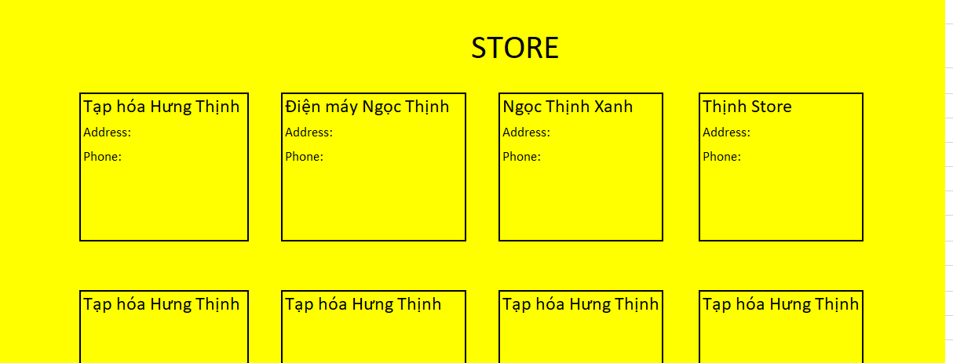
GUEST
View Store List

Slide 6
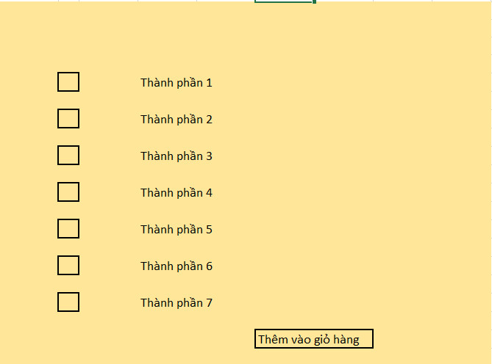
GUEST
Add Ingredient to cart

Slide 7
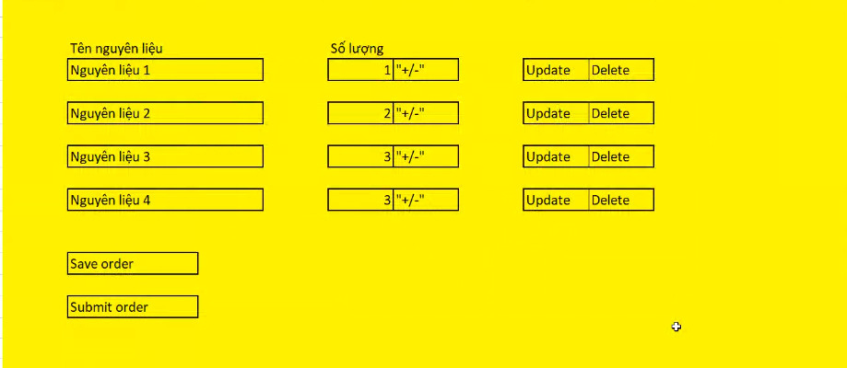
GUEST
CRUD cart

Slide 8
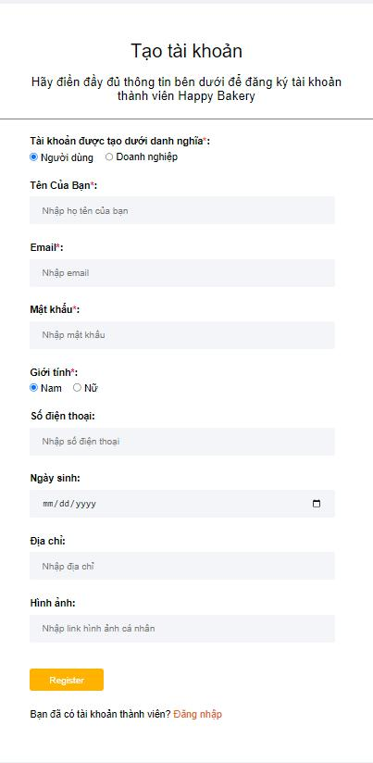
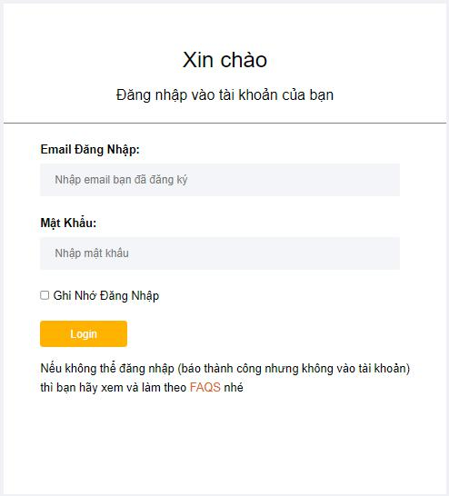
GUEST
Register/Login to User and Store

Slide 9
User CRUD Recipe
- CRUD Recipe
- Edit profile
- Comment, Rating recipe
- Edit cart and checkout

Slide 10
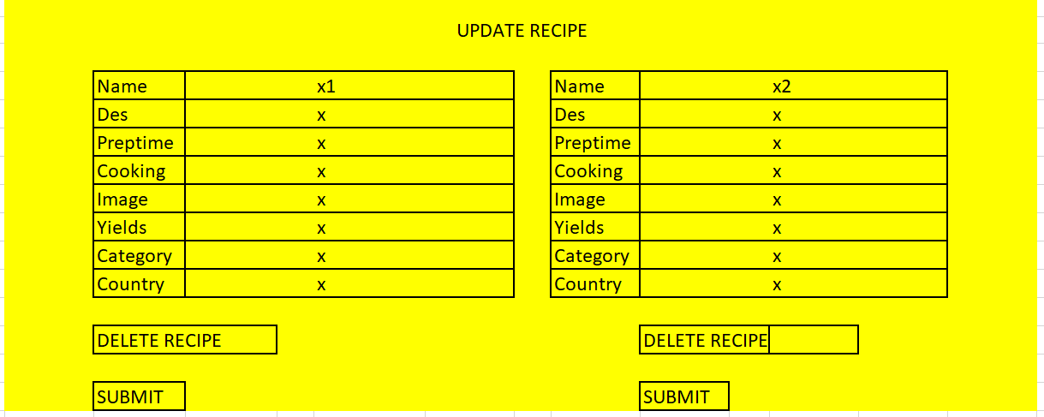
User CRUD Recipe

Slide 11
User Edit profile

Slide 12
User Comment, Rating recipe

Slide 13
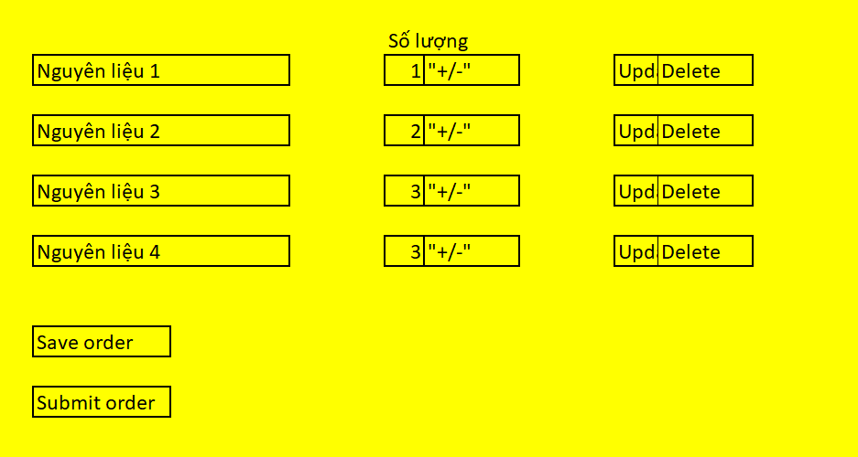
User Edit cart and checkout

Slide 14

Cylinder
This template has been created by Slidesgo

Slide 15

Octahedron
This template has been created by Slidesgo

Slide 16

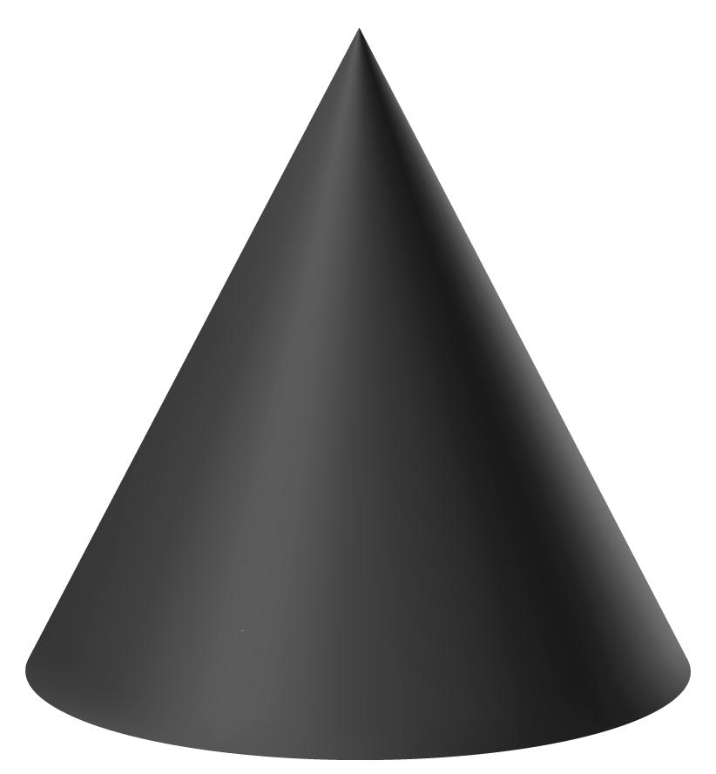
Cone
This template has been created by Slidesgo

Slide 17
Cube
This template has been created by Slidesgo

Slide 18
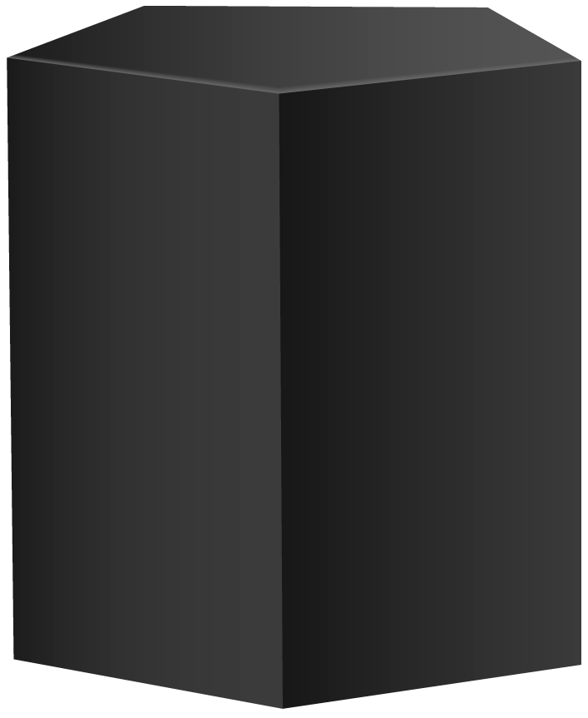
Pentagonal prism
This template has been created by Slidesgo

Slide 19



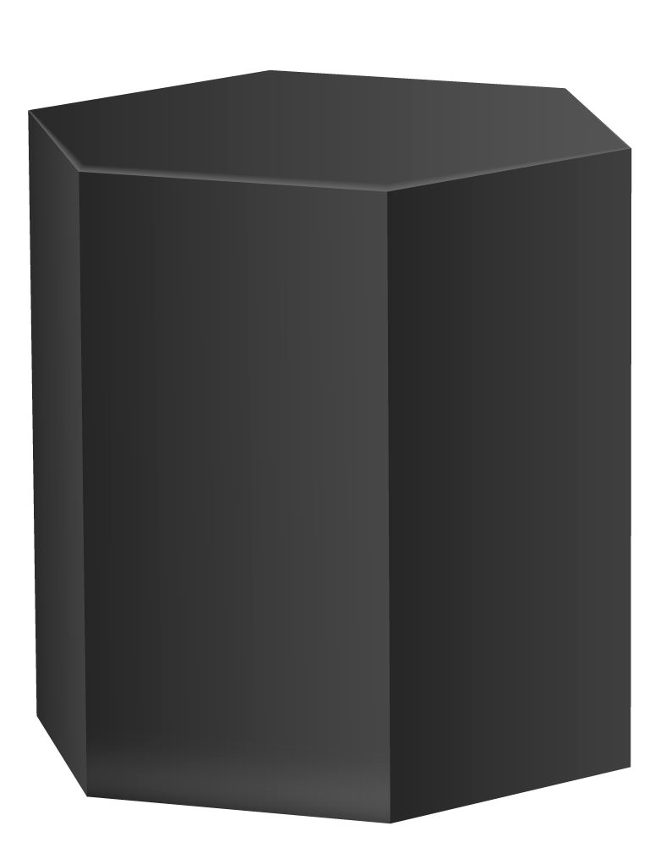
Thanks!
Do you have any questions?
addyouremail@freepik.com +91 620 421 838 yourwebsite.com
Please, keep this slide for the attribution

Slide 20





Alternative resources
Here’s an assortment of alternative resources whose style fits that of this template:
Vectors:
Collection tridimensional geometric shapes
Geometric shapes 3d effect

Slide 21
Resources
Did you like the resources on this template? Get them for free at our other websites:
Vectors:
Hand painted watercolor stains brush strokes
Solid geometric shapes set
Photos:
Minimalistic geometrical figures with copy space
Front view minimalistic geometrical figures
Student posing during group study
Young student learning library

